Slide 1
lake-microbiome
Sophia Yang

Slide 2
Datasets that we have….
coverm_431_MAGS_metagenomes_reads_count.csv (431 columns x 16rows)
Fw_ lake mendota data(envirrmental)
MAG_abundance_matrix_rel_abund.tsv (431 columns × 16 rows)
MAG_RPKM_normalized.tsv (431 columns × 16 rows)
MAG_taxonomy.tsv. (431 rows × 8 columns)
phages_abundance_matrix_metagenomes.tsv. (2246 columns not including the unmapped × 16 rows)
phages_rpkm_normalized_matrix.tsv (2246 columns not including the unmapped × 16 rows)
Samples-mendota.csv (10 columns × 16 rows)
2020 Profile Data Lake Mendota
ME_profile_071620.csv, ME_profile_072420.csv……. (describe the info for each of the sample measurements. Eg. Ph level, sample time, etc.) 12columns x21rows

Slide 3
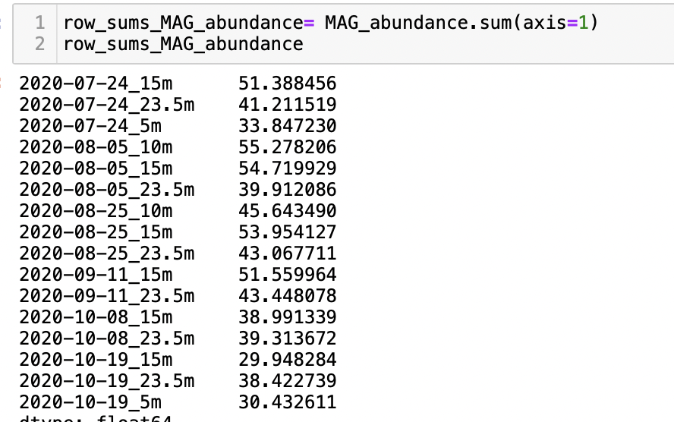
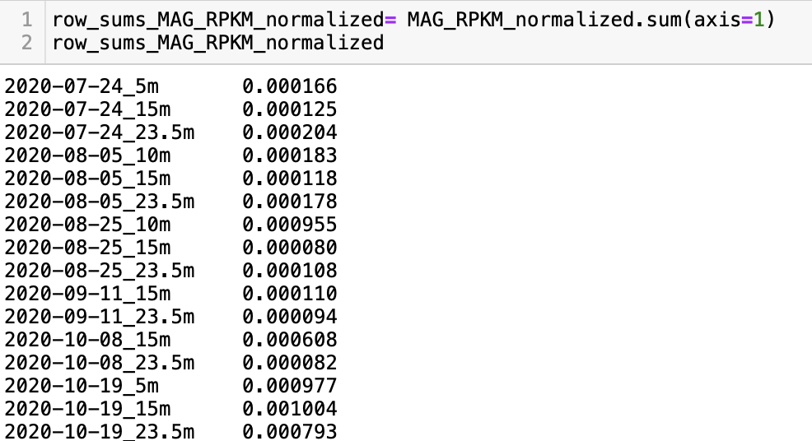
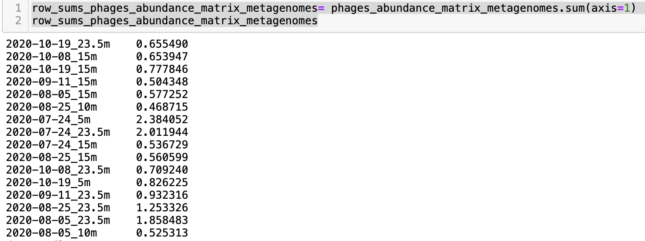
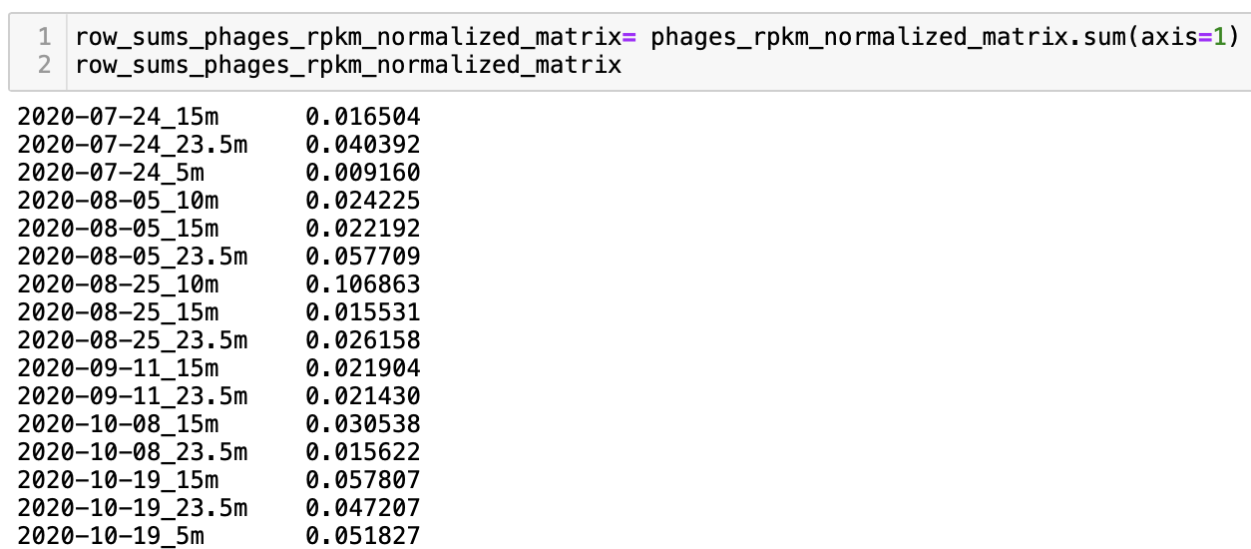
Row sum…(strange)
Fw_ lake mendota data(envirrmental)
MAG_abundance_matrix_rel_abund.tsv
MAG_RPKM_normalized.tsv
phages_abundance_matrix_metagenomes.tsv
phages_rpkm_normalized_matrix.tsv
Row sum does not sum to one??? Even for the normalized datasets

Slide 4
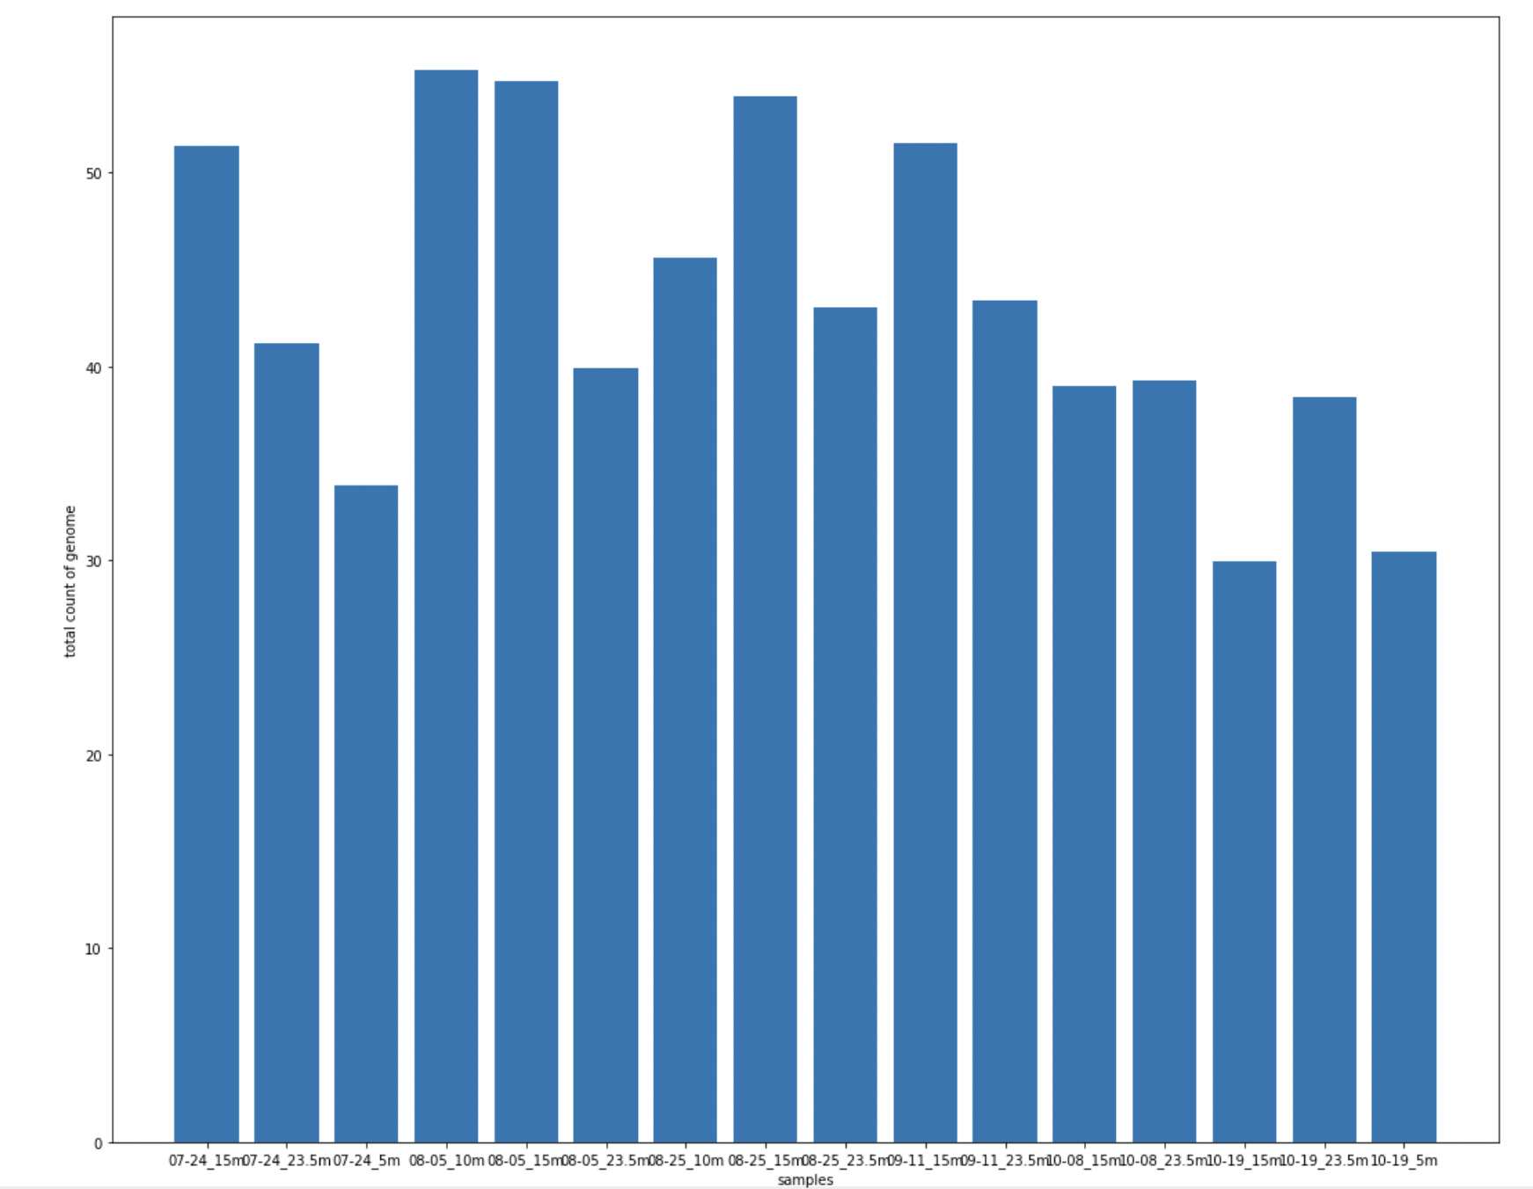
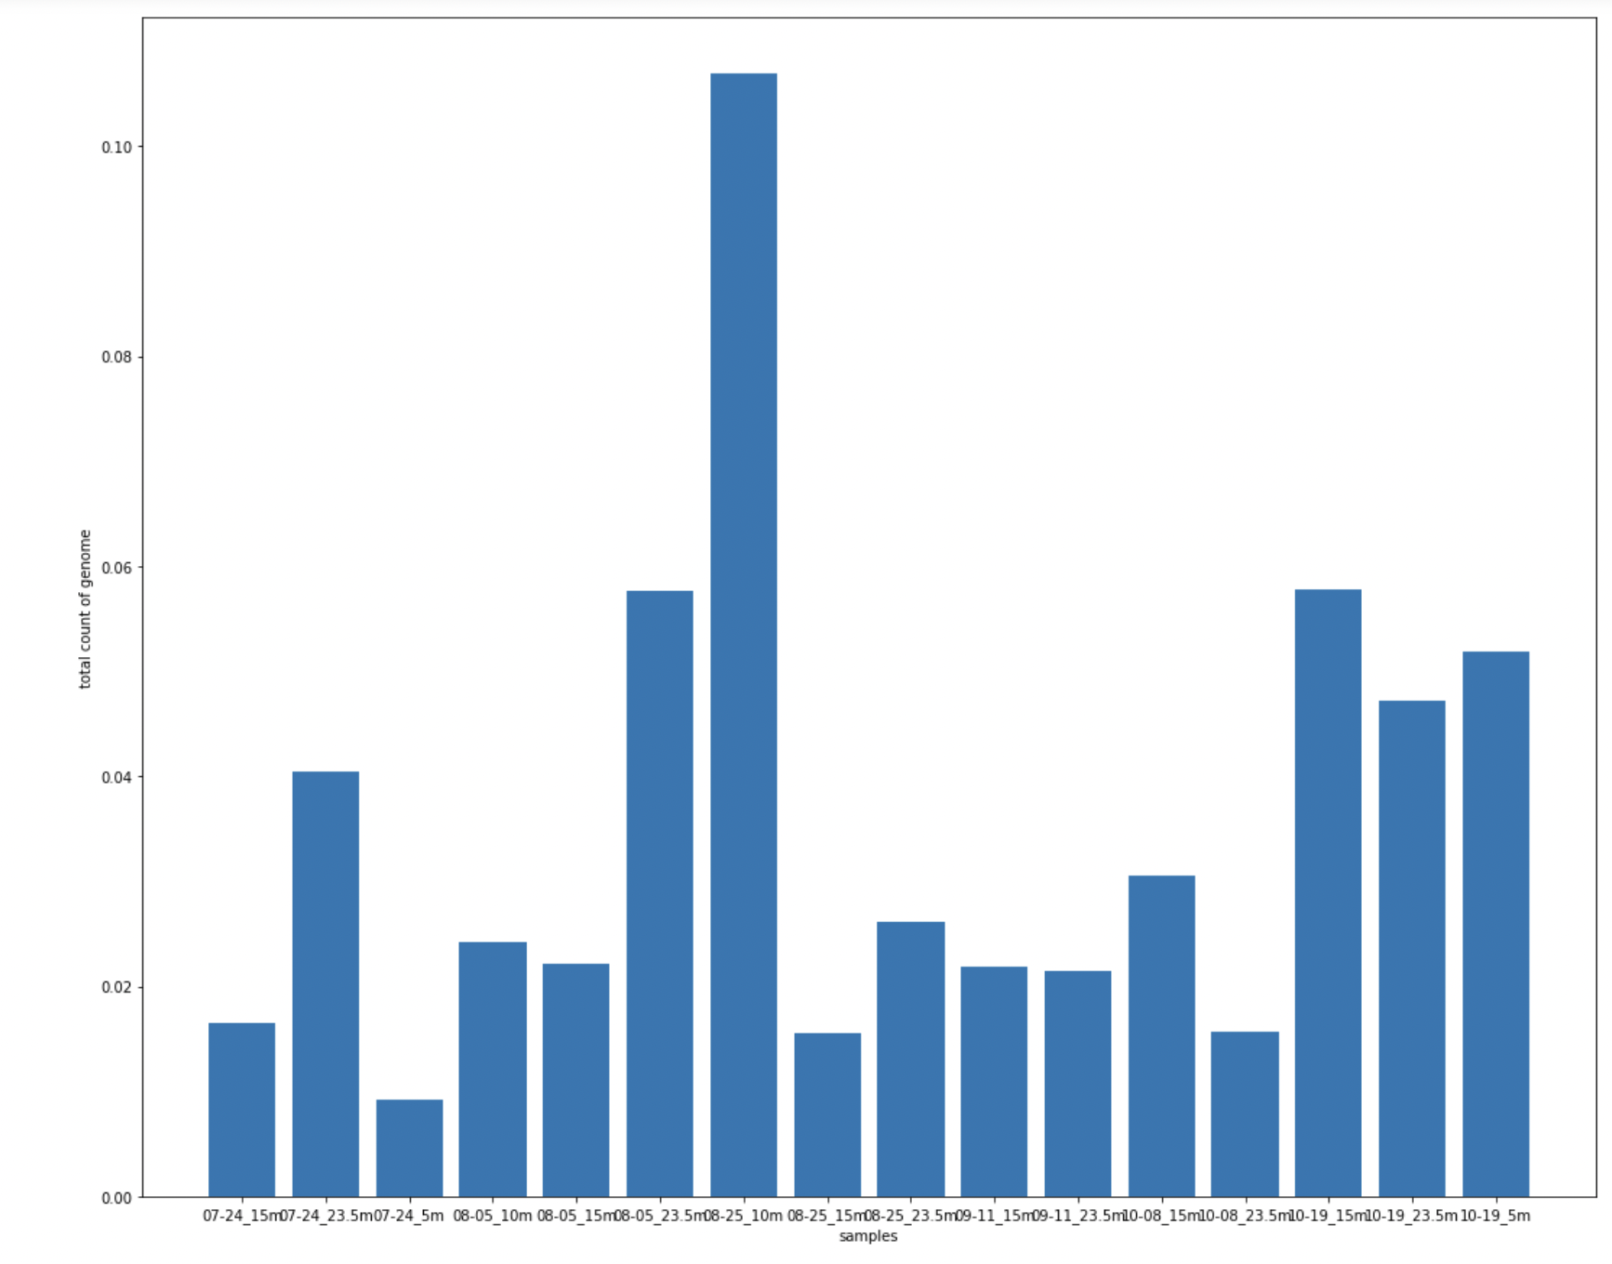
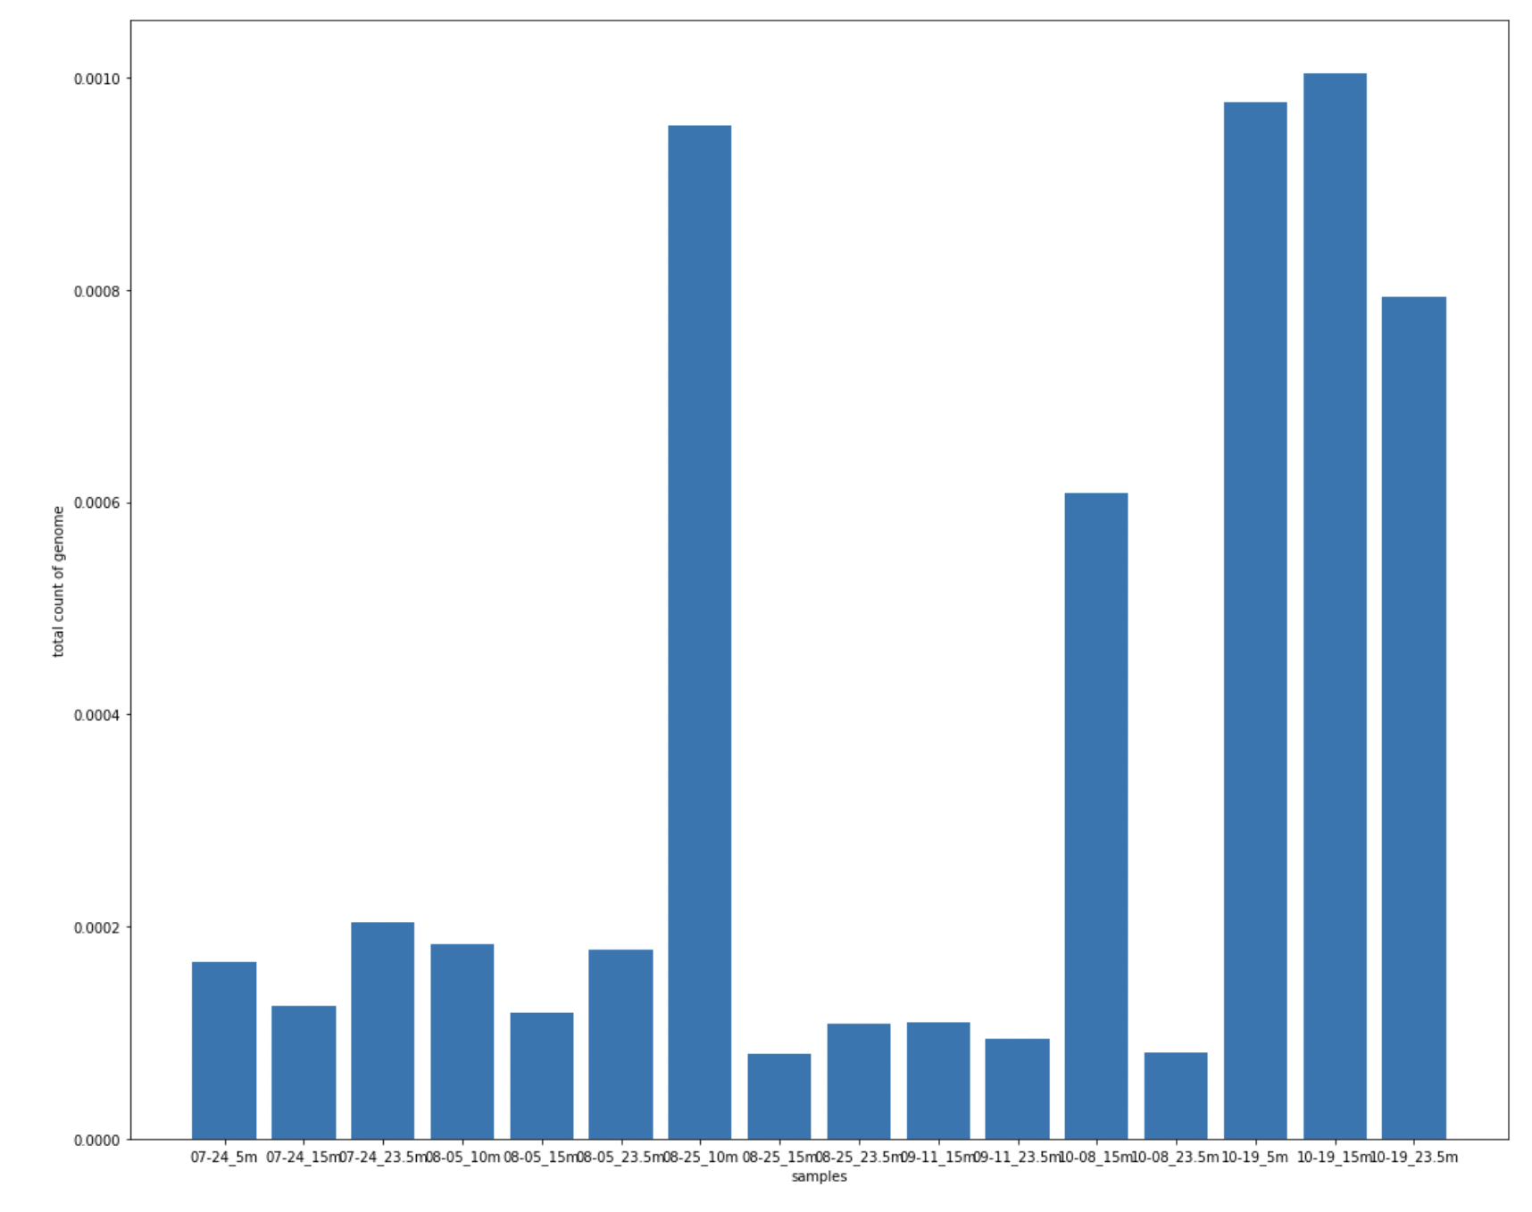
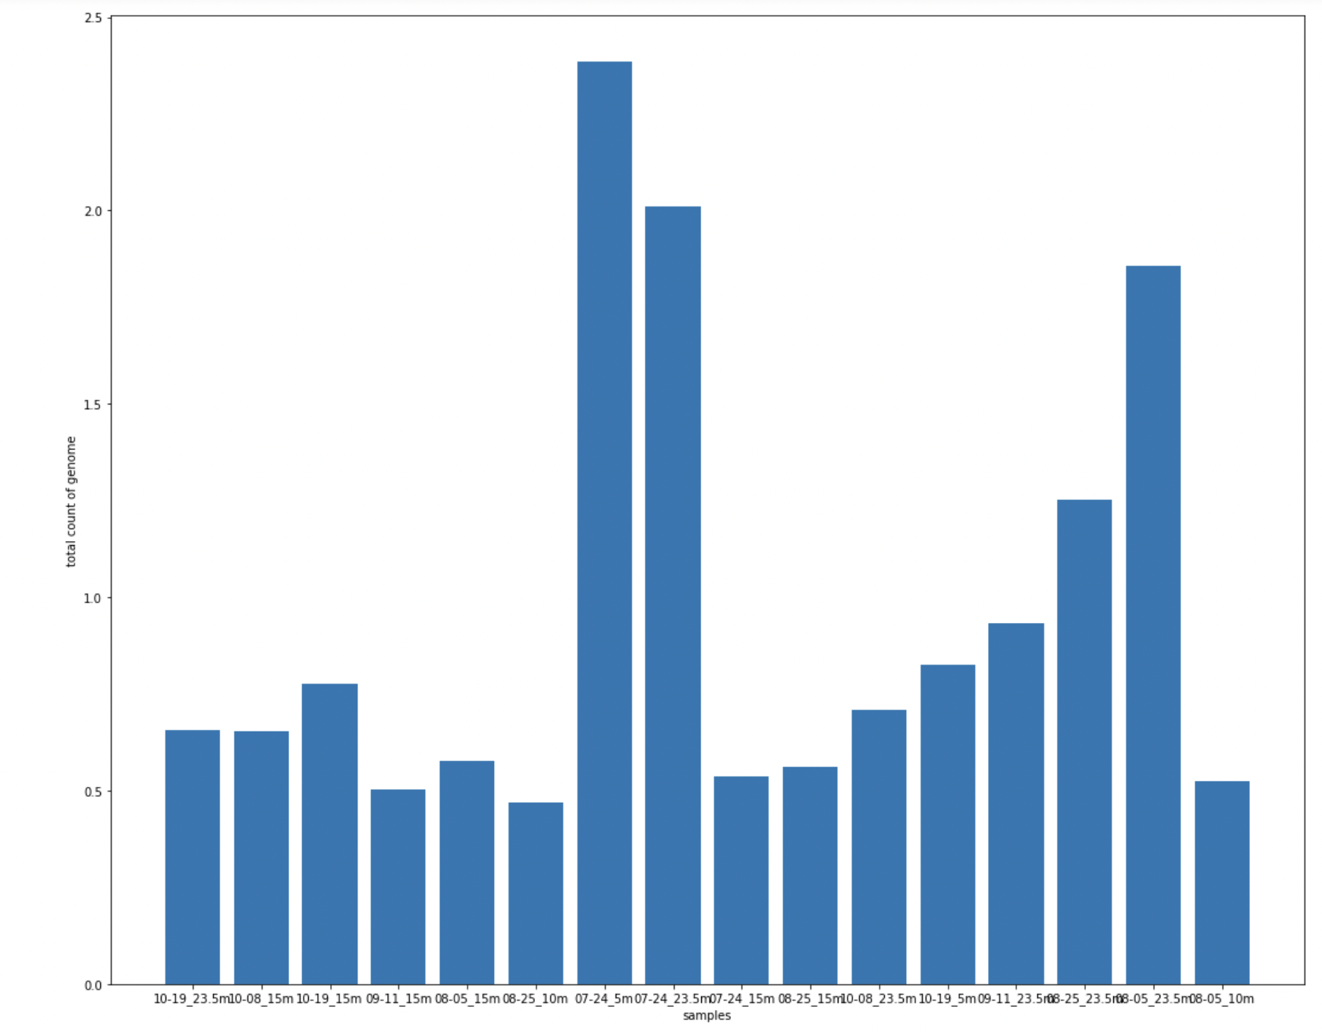
Lets take a look at of the row sum of each of the datset(they do not sum up to 1…)
phages_rpkm_normalized_matrix.tsv
MAG_abundance_matrix_rel_abund.tsv
phages_abundance_matrix_metagenomes.tsv
MAG_RPKM_normalized.tsv

Slide 5



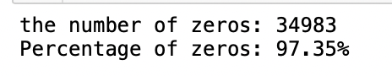
# of zeros
No zeros for the count dataset
1384 zeros for MAG_abundance_matrix_rel_abund.tsv
5893 zeros for MAG_RPKM_normalized.tsv
13125 zeros for phages_abundance_matrix_metagenomes.tsv
34983 zeros for phages_rpkm_normalized_matrix.tsv

Slide 6
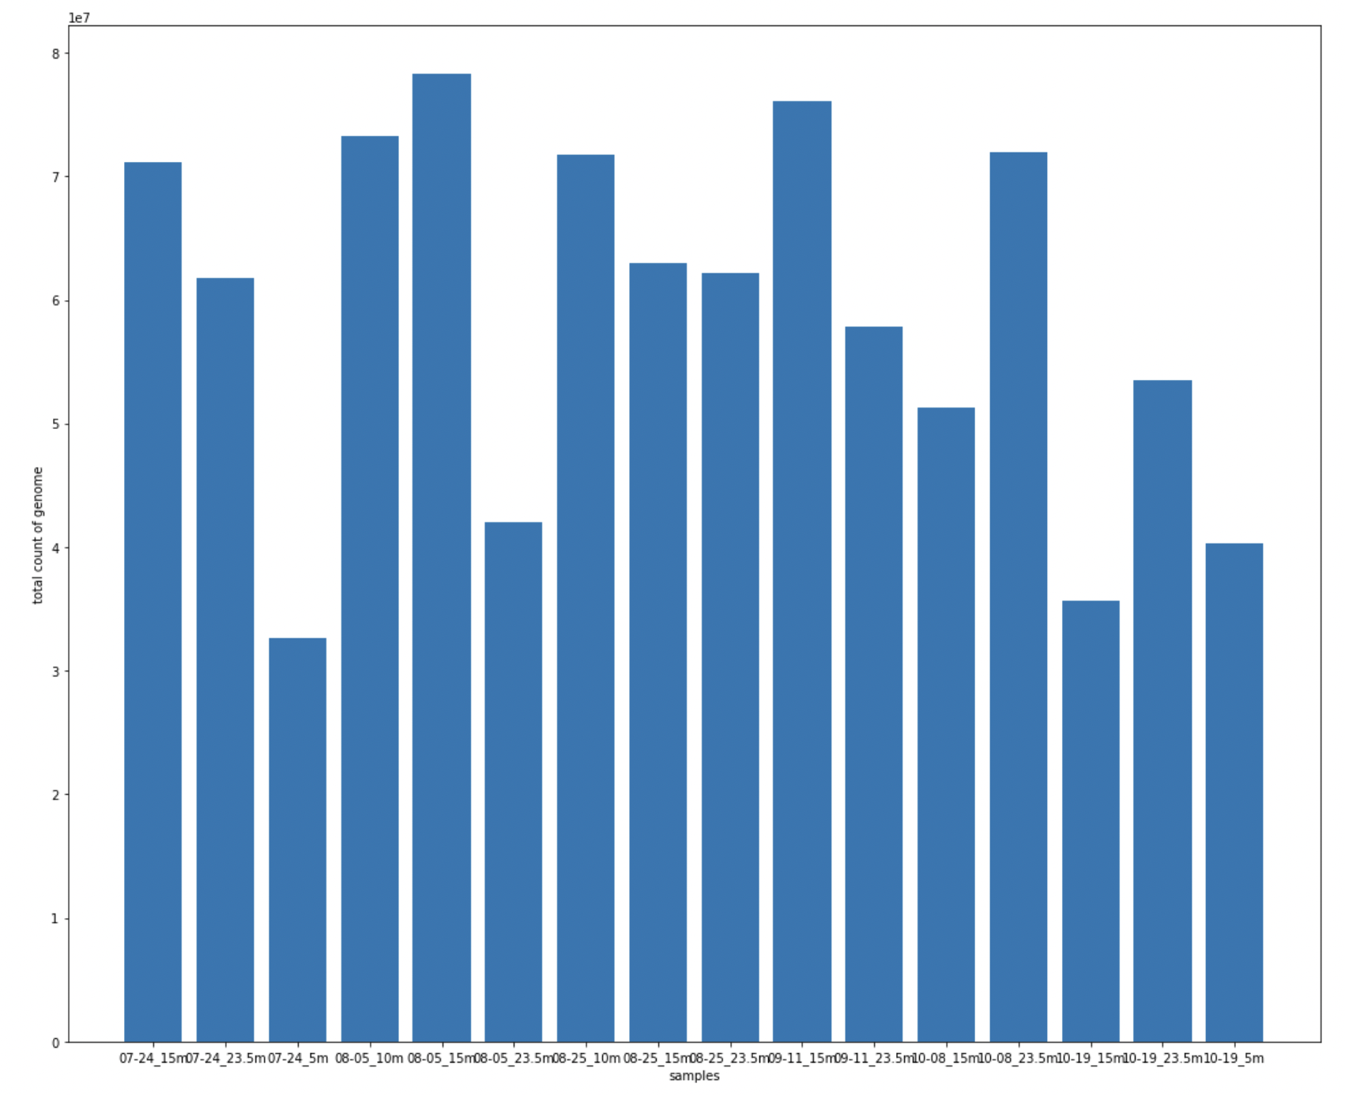
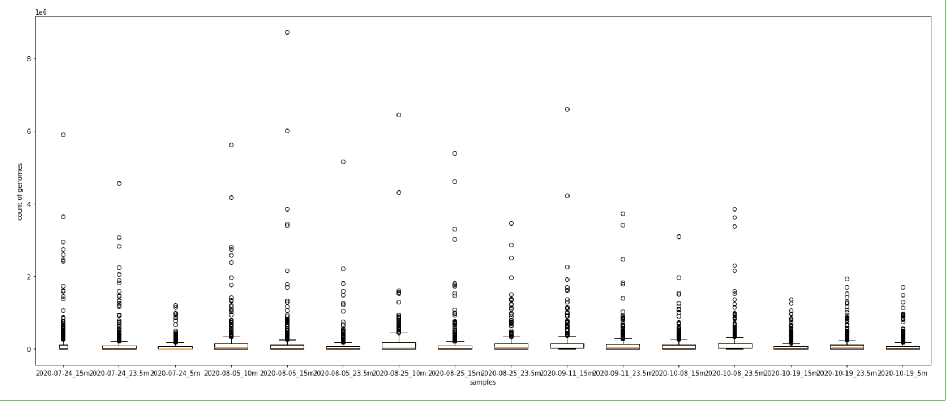
Take a look at of the count dataset…
Total count of genome per sample
Shallow depth less genome
Boxplot for dictribution of count of genome per sample
More outliers in the middle seasons

Slide 7
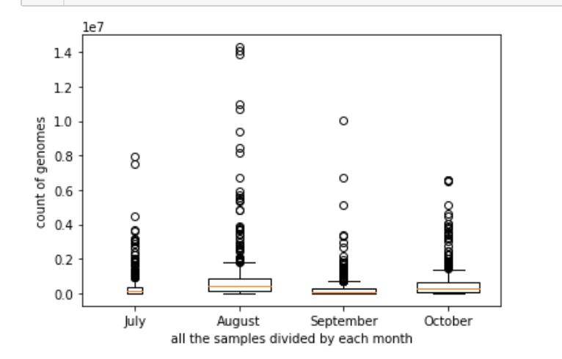
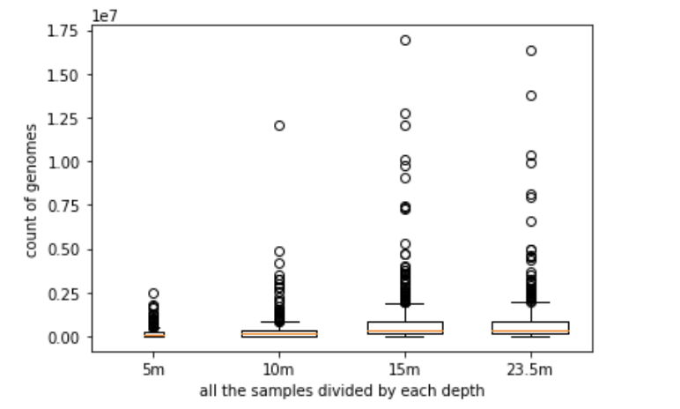
Continued(count dataset)…
Sum of count of each genome categorized by each month
Sum of count of each genome categorized by each depth
However more samples in August….
Since we have less sample data on depth 5 and 10m, less count is expected

Slide 8
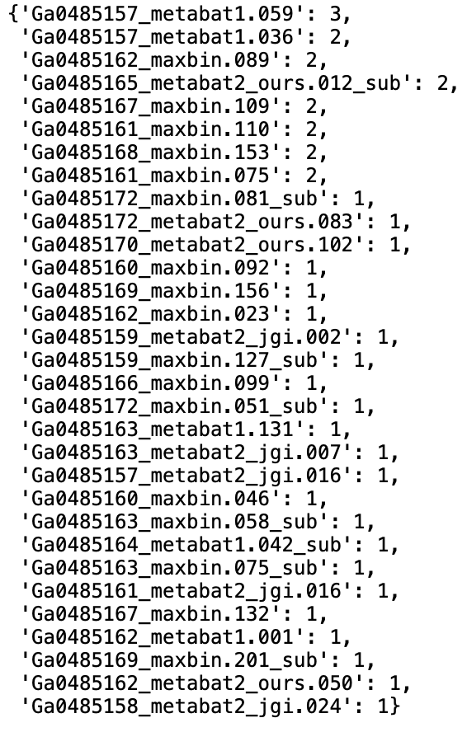
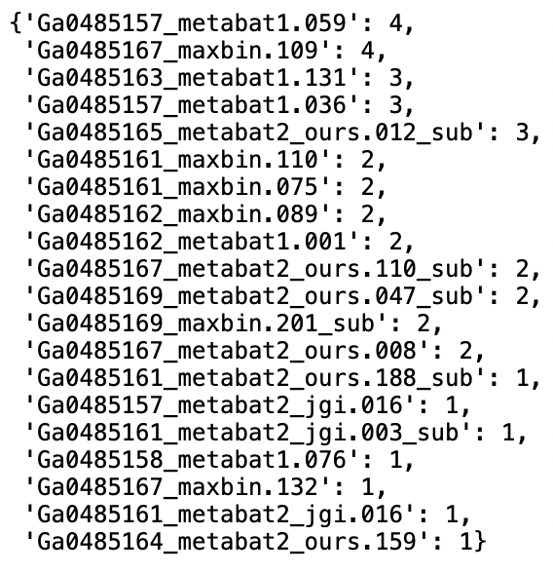
Still the count datset….
This time I am only focsuing on the most popular(count) top ten genomes that have appeared in all the depths
the most popular(count) top ten genomes that have appeared in all the months
Notes:
Shold use nomalize datasets!!!!

Slide 9
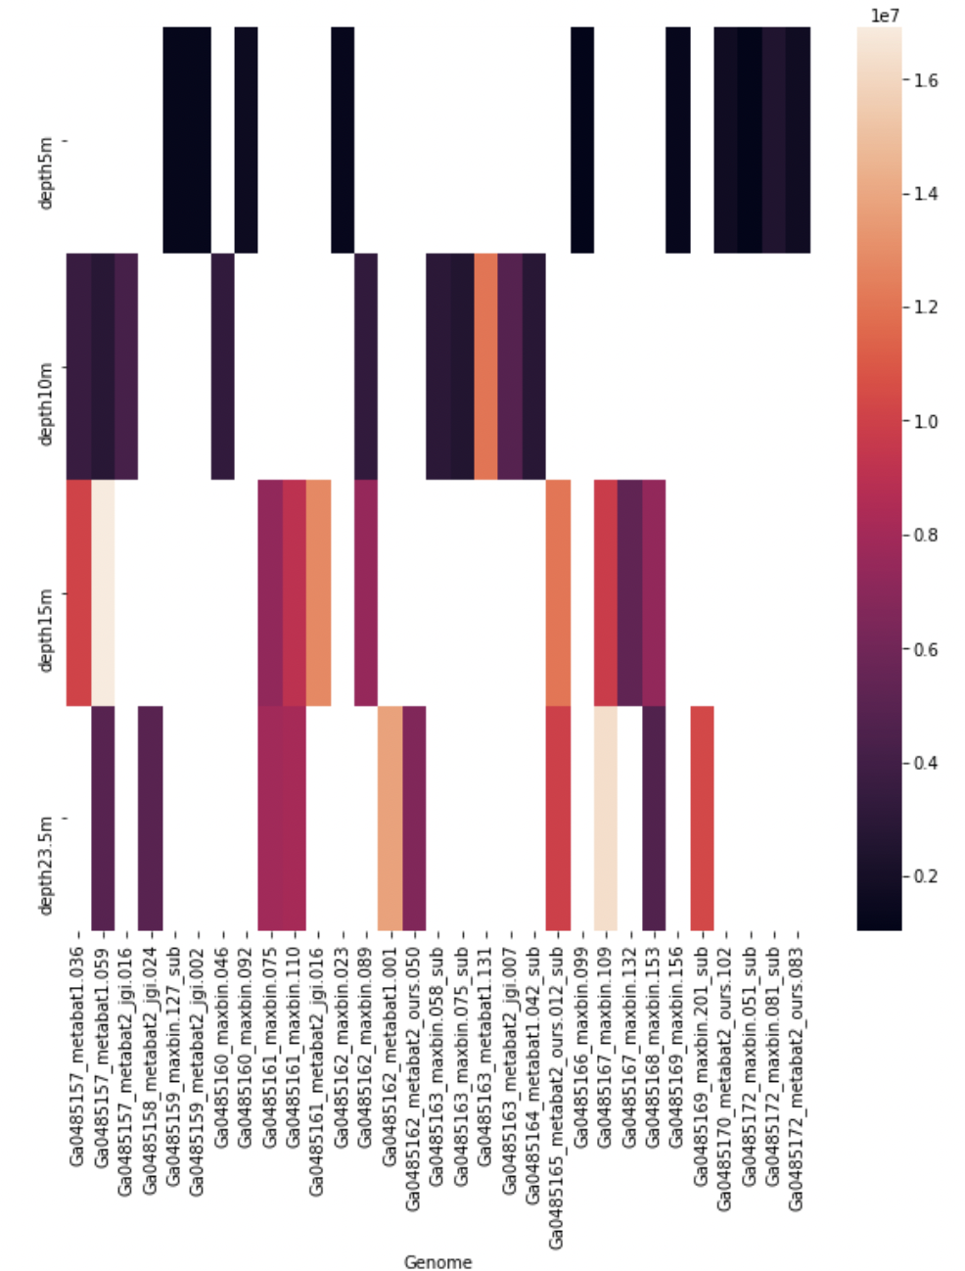
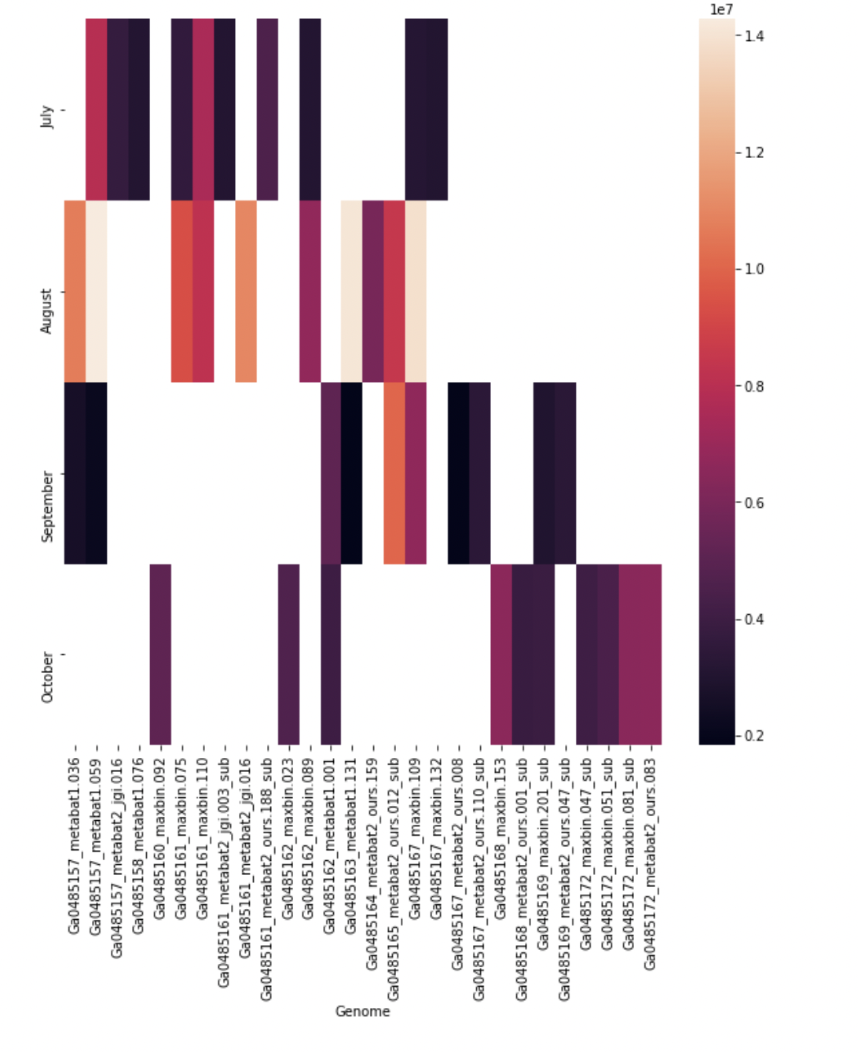
Heat Map…
#ploting heatmap for genome vs. month. However, we are only focusing ont he top 10 this time....
#ploting heatmap for top 10 genome vs. depth…

Slide 10
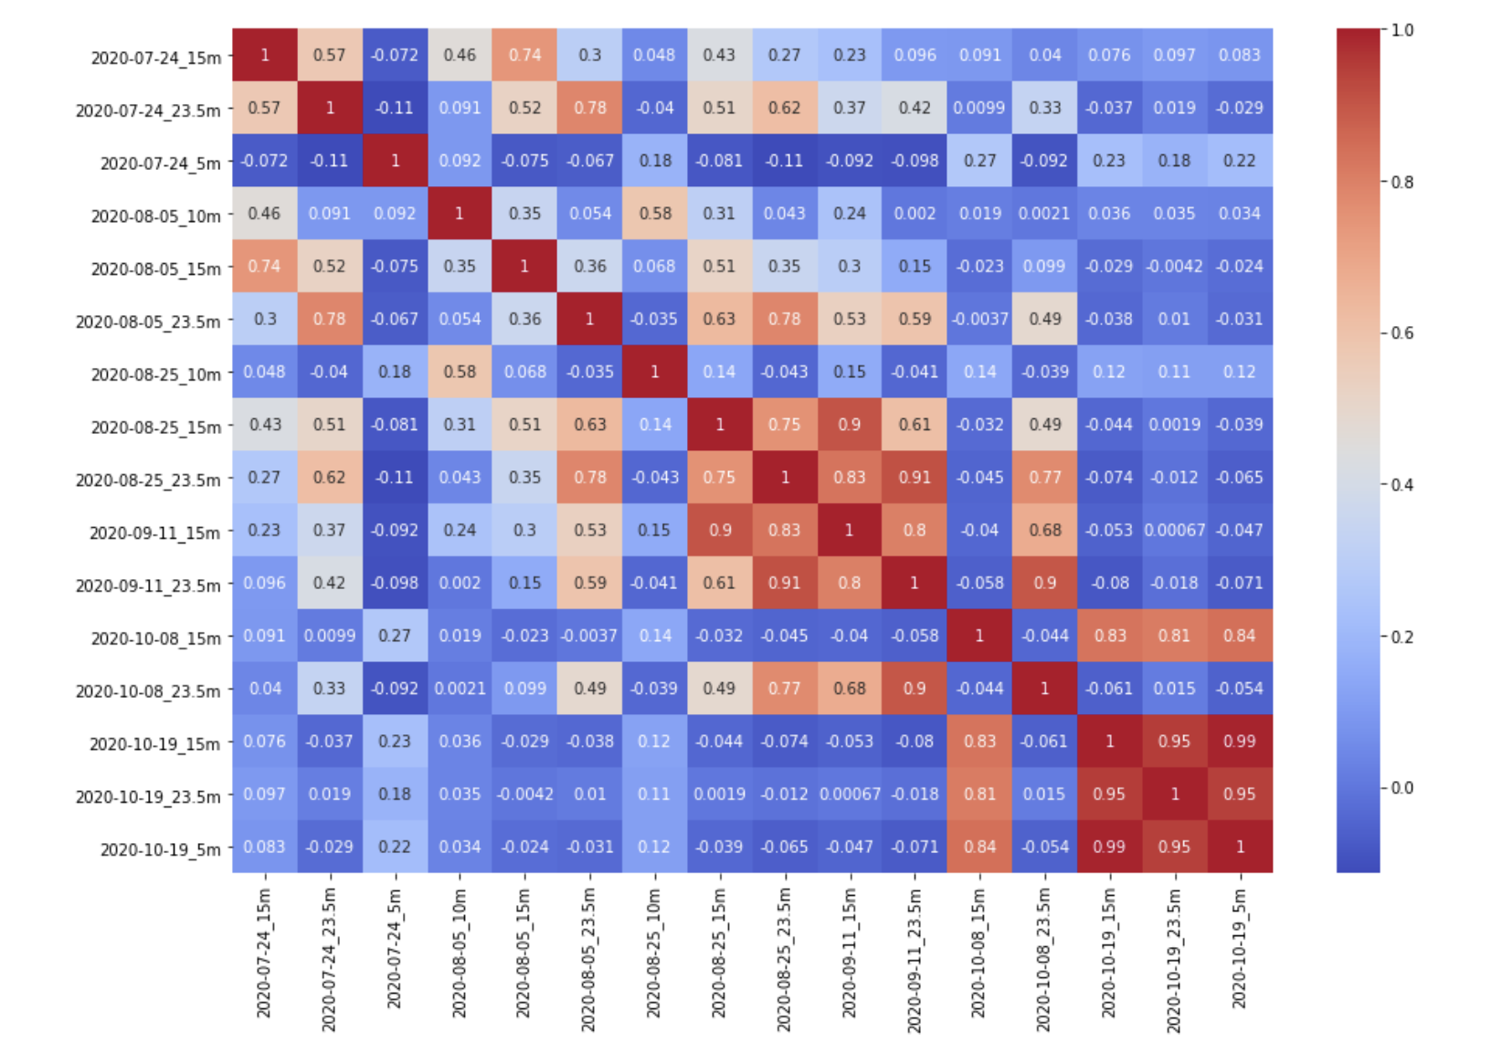
Correlation matrix of the count dataset

